Slide 1
A Programmer: needs an IDE
Python Programming

Slide 2
Visual Studio Code
Default install VSC
Install Extensions:
Python
Code Runner

Slide 3
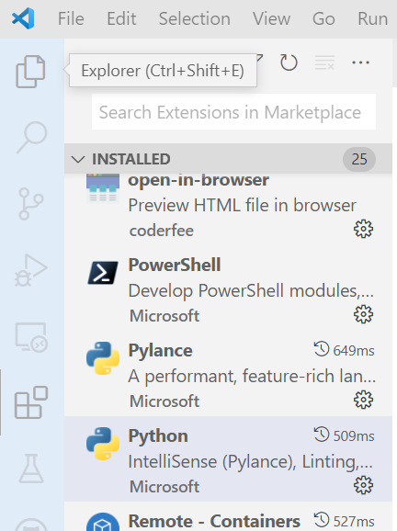
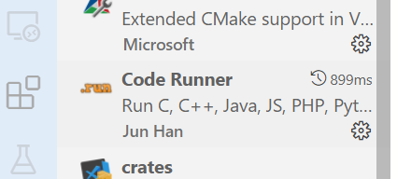
Install Extensions
3
1
2

Slide 4
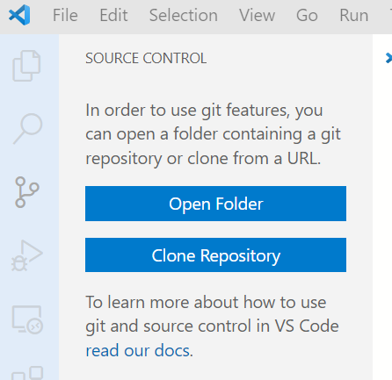
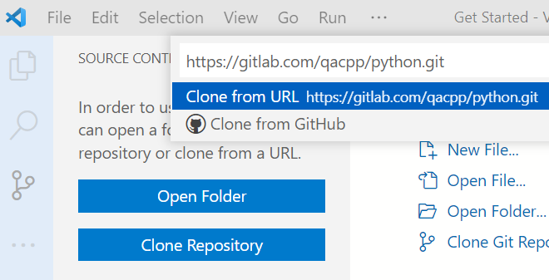
Clone Repository
If git is not already installed:
select install git
choose all default options
1
2
3

Slide 5
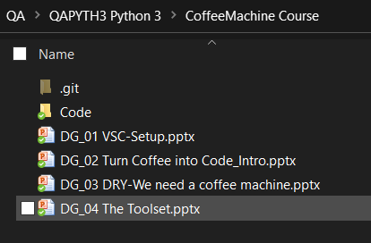
Clone to local folder
In file explorer:
Open powerpoint presentations

Slide 6
Materials
https://gitlab.com/qacpp/python.git
Get official course guide from:
https://mimeo.digital/
Create account
Redeem a Key: GBQ9TPLCTJLU

Slide 7
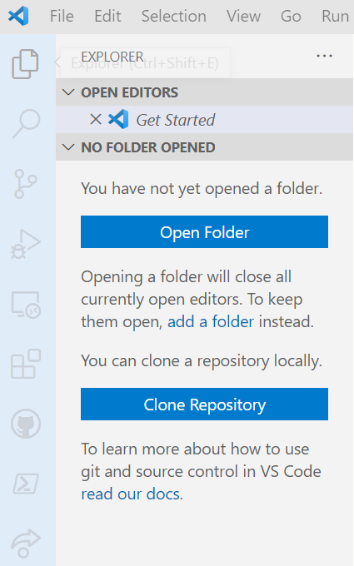
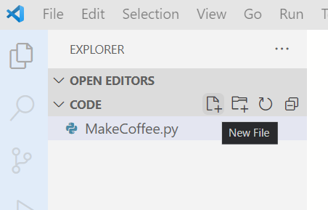
Open Folder
1
2
4

Slide 8
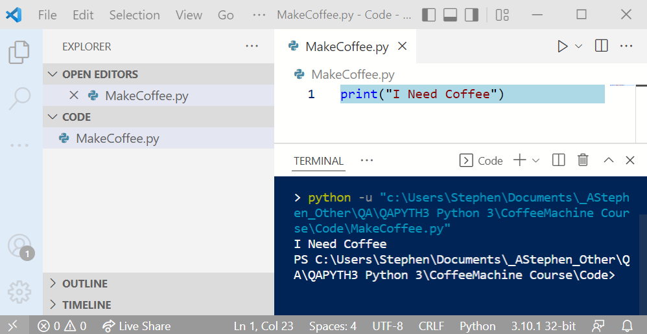
Run
3
2
1

Slide 9
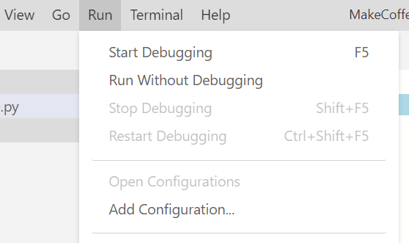
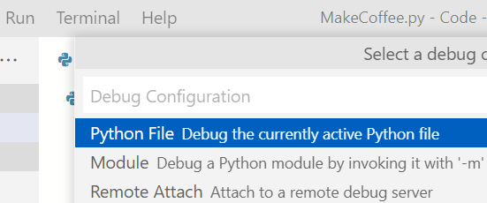
Configure Debug
1
2
3

Slide 10
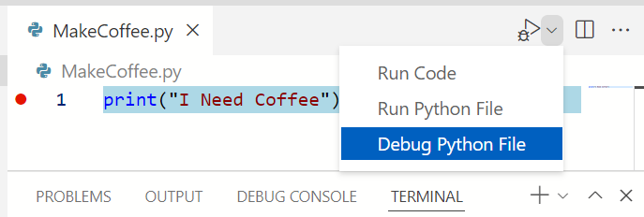
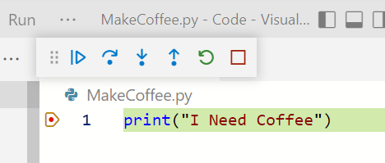
Debug
2: drop-down
1. F9
3

Slide 11
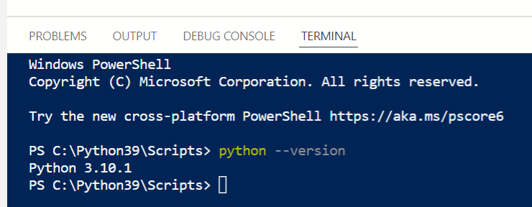
Install Python 3.10
1
2
If version is not 3.10 or higher:
Browser: python.org/downloads

Slide 12
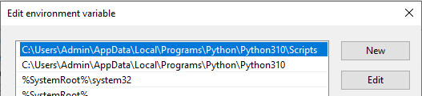
Windows env variables
Start->"env"
Edit system path
add path to python 3.10

Slide 13
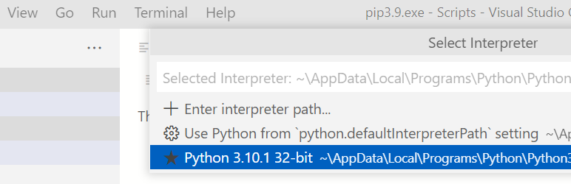
VSC Select Interpreter
View-> Command Pallete
->python:Selected Interpreter

